Slide 1




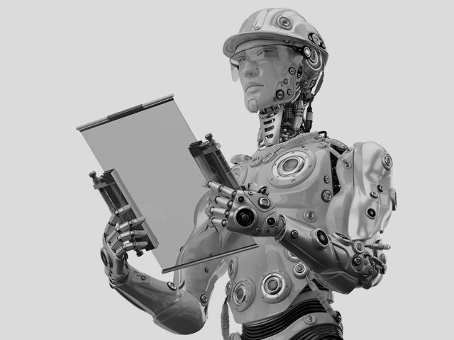


Stream Name
CHARRU MALHOTRA, Ph.D. (IIT-D)
Agenda
01
02
03
04
05

Slide 2


Digital Diplomacy
E-Diplomacy for Public Diplomacy

Slide 3



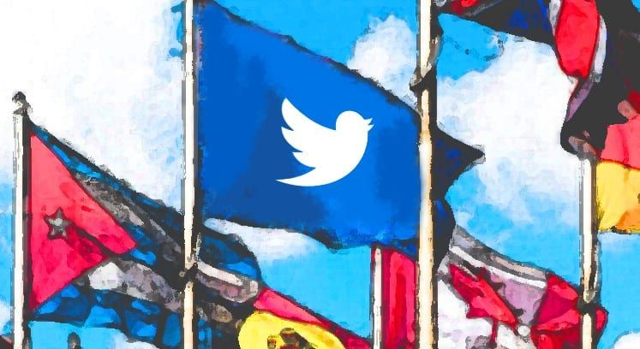


Failures of e-Diplomacy
Cyber Diplomacy

Slide 4




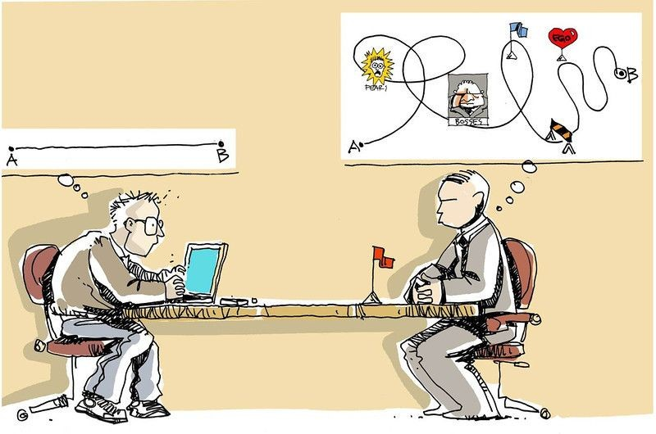


Cyber Diplomacy- World & India
Role of Diplomats in Cyber Issues

Slide 5

Way Forward For Cyber Diplomacy
References

Slide 6





