Slide 1
Stream Name
Policy and Regulatory Framework for GovTech
Session Number: 06
Session Topic:
Policy Debates on AI and Related Issues : Ethics ,DeepFake, JobLoss
CHARRU MALHOTRA, Ph.D. (IIT-D)
COORDINATOR ( Centre of e-Governance) Associate Professor (e-Governance and ICT) Indian Institute of Public Administration charrumalhotra [at]gmail.com
charrumalhotra[dot]iipa[at]gov[dot]in
1

Slide 2
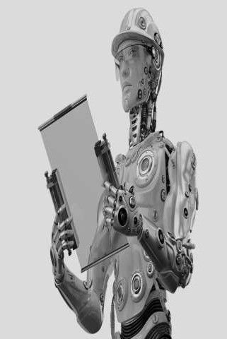
Agenda
01
AI Timeline
02
Key Challenges
03
Research
04
Skilling for the AI age
05
Accelerating Adoption
06
Responsive AI Development
07
Frameworks for Regulation
charrumalhotra[dot]iipa[at]gov[dot]in
2

Slide 3

Stephen Hawking
The real risk with AI isn’t malice but competence. A super intelligent AI will
be extremely good at accomplishing its goals, and if those goals aren’t
aligned with ours, we’re in real trouble.
charrumalhotra[dot]iipa[at]gov[dot]in
3

Slide 4
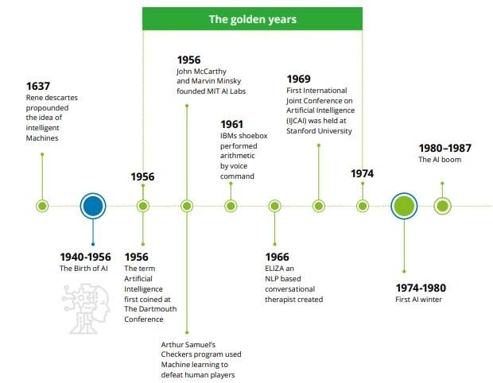
AI: The story so far
Timeline of AI
4

Slide 5
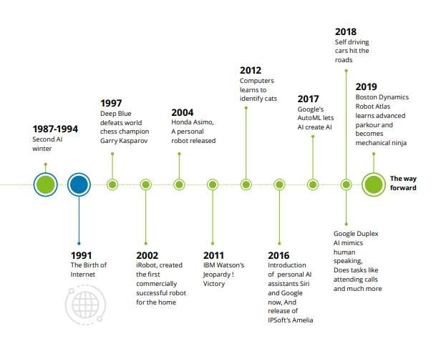
AI: The story so far Contd….
5

Slide 6

Key Considerations for AI Policymaking in India
Resources, Infrastructure, Markets, and
Funding
Ensure adequate government funding and investment in R&D
Democratize AI technologies and data
Re-thinking Intellectual Property
Regimes
National infrastructure to support domestic development
https://cis-india.org/internet-governance/blog/ai-in-india-a-policy- agenda
charrumalhotra[dot]iipa[at]gov[d⁶ot]in

Slide 7

Key Challenges
Lack of enabling data ecosystems
Low intensity of AI research
  Core research in fundamental technologies
  Transforming core research into market applications
Inadequate availability of AI expertise, manpower and skilling opportunities
High resource cost and low awareness for adopting AI in business processes
Unclear privacy, security and ethical regulations
Unattractive Intellectual Property regime to incentivise research and adoption of AI
https://niti.gov.in/writereaddata/files/document_publication/NationalStrategy-for-AI-Discussion-Paper.pdf
charrumalhotra[dot]iipa[at]gov[dot]in
7

Slide 8

1. Research
Pursuing excellence in research in Artificial Intelligence
Suggestive technology topics could include:
General AI
Opening the Black Box / Explainable AI
Advanced anonymisation protocols for
data security and privacy
Ethics in AI
AI approach to solving world’s biggest problems in healthcare, education, urbanisation, agriculture etc.
https://niti.gov.in/writereaddata/files/document_publication/NationalStrategy-for-AI-Discussion-Paper.pdf
charrumalhotra[dot]iipa[at]gov[dot]in
8

Slide 9


Some Global Initiatives in Research
CERN for AI
The European Organisation for Nuclear Research kind of model, they are sharing their results with the world, rather than restricting them to a single country or corporation.
Open AI
Set up by the likes of Elon Musk and Sam Altman
Mission to discover and enact the path to safe artificial general intelligence.
Declaration on Cooperation in Artificial Intelligence signed by 25 states of European Union on 10th April 2018
Commitment and collaboration of truly international standards to develop and ensure #AIforAll1
https://niti.gov.in/writereaddata/files/document_publication/NationalStrategy-for-AI-Discussion-Paper.pdf
charrumalhotra[dot]iipa[at]gov[dot]in
9

Slide 10

2. Skilling for the AI age
Getting India ready for the AI wave
Recommendations;
Two-pronged approach for AI skilling, one set of interventions aimed at
the workforce and the second for the students.
Workforce
  Integration with relevant existing skilling initiatives
  Building of new platforms for improved learning
  Large scale employment generation through
promotion of AI
Students
  Transition from knowledge intensive to computer based relevant education
  Develop applied skills in a continuously changing job environment
https://niti.gov.in/writereaddata/files/document_publication/NationalStrategy-for-AI-Discussion-Paper.pdf
charrumalhotra[dot]iipa[at]gov[dot]in
10

Slide 11

3. Accelerating Adoption
AI across the value chain
78% of firms globally using AI extensively or have
plans (2017 survey by Statista)
only 20% use any AI related technology at scale (Survey of non IT sector, 3,000 AI-aware top mgmt executives, 10 countries and 14 sectors)
Orgs. invested USD26 – USD39 billion in AI while USD6 – USD9 billion invested in startups in the year 2016
Only 22% of the firms in India use AI
Indian startups raised just USD87 million in 2017, Chinese startups raised over USD28 billion in 2017
https://niti.gov.in/writereaddata/files/document_publication/NationalStrategy-for-AI-Discussion-Paper.pdf
charrumalhotra[dot]iipa[at]gov[dot]in
11

Slide 12

Accelerating Adoption: Recommendations
Creating a multi-stakeholder Marketplace
Facilitating creation of large
foundational annotated data sets
Partnerships and collaboration
Spreading awareness on the
advantages AI offers
Supporting startups
charrumalhotra[dot]iipa[at]gov[dot]in
12

Slide 13

4. Responsive AI Development
Fairness
Responsive AI
Development
Security
Interpretability
Privacy
charrumalhotra[dot]iipa[at]gov[dot]in
13

Slide 14
Fairness
AI systems for critical tasks, such as predicting the presence and severity of a medical condition, matching people to jobs and partners, or identifying if a person is crossing the street.
Approach
Addressing fairness and inclusion in AI is an active area of research,
from
Fostering an inclusive workforce having critical and diverse
knowledge
Assessing training datasets for potential sources of bias
Training models to remove or correct problematic biases
Evaluating machine learning models for disparities in
performance
Continued testingchaorrfumfianlhaotlras[ydostt]ieipma[ast]gfoov[rdout]inn fair outcomes.
14

Slide 15
Interpretability
Interpretability is crucial to being able to question, understand, and trust AI systems. Interpretability also reflects our domain knowledge and societal values, provides scientists and engineers with better means of designing, developing, and debugging models, and helps to ensure that AI systems are working as intended.
Recommendations
Plan out your options to pursue interpretability | Treat interpretability as a core part of the user experience
Design the model to be interpretable | Choose metrics to reflect the end-goal and the end-task
Understand the trained model | Communicate explanations to model users
https://ai.google/responsibilities/responsible-ai-practices/
charrumalhotra[dot]iipa[at]gov[dot]in
15

Slide 16
Privacy
Although there may be enormous benefits to building a model that operates on sensitive data (e.g., a cancer detector trained on a dataset of biopsy images and deployed on individual patient scans), it is essential to consider the potential privacy implications in using sensitive data.
This includes not only respecting the legal and regulatory requirements, but also
considering social norms and typical individual expectations.
Recommendations
Collect and handle data responsibly
Leverage on-device processing where appropriate
Appropriately safeguard the privacy of ML models
charrumalhotra[dot]iipa[at]gov[dot]in
16

Slide 17
Security
Hard to predict all scenarios ahead of time, especially when ML is applied to
problems that are difficult for humans to solve.
Hard to build systems that provide both the necessary security as well as the
flexibility to generate creative solutions
As AI technology develops, attackers will surely find new means of attack; and
new solutions will need to be developed in tandem.
Recommendations
Identify potential threats to the system
Develop an approach to combat threats
Keep learning to stay ahead of the curve
charrumalhotra[dot]iipa[at]gov[dot]in
17

Slide 18
Challenges for the development of effective AI policies
Lack of data, especially for developing countries
Inconsistent forecasting ( Forecasting on the impacts of AI are inconsistent )
Lack of public debate:
Lack of human capacity, especially government officials and policymakers, in developing AI policy
Source: https://www.unescap.org/sites/default/files/ESCAP_Artificial_Intelligence.pdf
18

Slide 19
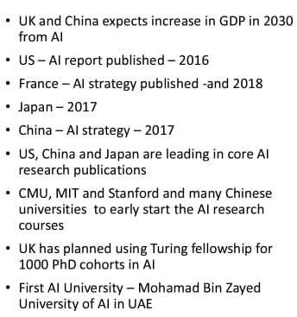
Recommendations: Need for New Legal &
Regulatory (L&R) Framework
1. Need for an AI Act
Need an Agile, Recursive , Pre-event, Co-created L & R framework
Privacy, Ethics and Empathy by
design
Co-Compete to Dilute Monopolies /
Proprietary - Controls
Insistence on Localization and
Democratization of AI
Contextualise : Train datasets for safe use of AI to
accept Indian diversity
Citizen-centric : Rightful use of AI to solve problem for all society layers
National Strategy for AI #AI for
All, June2018, Niti Ayog
AI for School Children, 2020,
NitiAyog
(Source : Prof Kiran Trivedi, VGEC, Chandkheda, Gujarat krtrivedi@vgecg.ac.in)
AIRAWAT (AI Research, Analytics and Knowledge Assimilation Platform), Approach paper ,NITI Aayog, Jan 2020
It aims to tackle the challenges
related to the lack of access to
s
6.

Slide 20
Need for Proactive laws: Recommendations Contd..
National legislation
Data Protection Law
  Discrimination Law
    Competition Law
Consumer Protection Law
  Sectoral Regulation
charrumalhotra[dot]iipa[at]gov[dot]in
20

Slide 21

Way Forward for India
ACCESSIBILITY
ADAPTABILITY/ INCLUSIVENESS
Last-mile solutions
(Digital India, BharatNet)
@MySocialResponsibility
One
Co-Create – humans, tele & autonomous robots, academia, industry, practioners , civil society & ethical masters to solve problems of society
An Edu f/w that teaches not just ‘AI’
Nation _{AI for}
Digital Daan/ Donate/ Teach/ Gift/ Share
Up-skill All
All
AI@Doorsteps
One
(Mission KaramYogi, PMGDisha)
Platform
Aatmanirbha r AI
(Self- Reliant AI)
AFFORDABILITY
but
‘AI with human
touch’
(Responsible AI for Youth)
‘Make in India’, ‘Made for India’ , ‘Made by Indians’
R&D ; Lure StartUps/ VCs; Testbeds; Industry & Academia Innovate (RAISE-2020);
(Go LOCAL- Local manufacturing, local markets, local supply chain) & by locals

Slide 22
References/Further Reading
1. How The UK Government Uses Artificial Intelligence To Identify Welfare
And State Benefits Fraud. (n.d.). Retrieved June 27, 2020, from
https://bernardmarr.com/default.asp?contentID=1585
2.
Kirsh, D. (1991). Foundations of AI: the big issues. Artificial intelligence,
47(1-3), 3-30.
3. GOI AI Discussion Paper : https://niti.gov.in/writereaddata/files/document_publication/NationalStr ategy-for-AI-Discussion-Paper.pdf and https://cis-india.org/internet- governance/blog/ai-in-india-a-policy-agenda
4.
Google AI. (n.d.). Responsible AI Practices –. Retrieved from
https://ai.google/responsibilities/responsible-ai-practices/
TED talks
  The danger of AI is weirder than you think
  Are you Ready for Artificial Intelligence
charrumalhotra[dot]iipa[at]gov[dot]in

Slide 23


Our next session would be on :
Digital Diplomacy: Need for Newer Frameworks
Any questions?
You can find me at:
Charrumalhotra[dot]iipa[at]gov[dot]in
charrumalhotra[dot]iipa[at]gov[dot]in 23

