Slide 1



Stream Name
Policy and Regulatory Framework for GovTech
Session Number: 04
Session Topic:
Digital Sovereignty & Mergers /Acquisition
CHARRU MALHOTRA, Ph.D. (IIT-D)
COORDINATOR ( Centre of e-Governance)
Associate Professor (e-Governance and ICT) Indian Institute of Public Administration charrumalhotra [at]gmail.com
charrumalhotra[dot]iipa[at]gov[dot]in
1
Agenda
01
What is Data Sovereignty?
02
Three Disputes Over Data Sovereignty
03
The Jio- Facebook Deal
04
The Implications & Possibilities of the Deal
charrumalhotra[dot]iipa[at]gov[dot]in
2

Slide 2


What is Data Sovereignty?
It refers to the field of internet governance
-To describe government’s desire to exercise control over the internet within their own borders, including political, economic, cultural and
technological activities.
Differences
Concepts | Meaning
Data Residency | Address of Data
Data Sovereignty | Stored and follows laws of the nation where it is stored.
Data Localization | Stay with the country and shared with other countries over taxes.
charrumalhotra[dot]iipa[at]gov[dot]in
3
Three Disputes Over Data Sovereignty
Cyber security has emerged as a global challenge
Becoming a tier one security threat for sovereign states.
International Debates on
  Rules of cyberspace,
  systemic and revolutionary challenges to
global governance in cyberspace.
Some consensus was originally achieved by Inf. Security Group of Governmental Experts (GGE), UN
BUT … deep differences and doubts continue to divide the international community, particularly with respect to three issues.
charrumalhotra[dot]iipa[at]gov[dot]in
4
(Source: https://cco.ndu.edu/PRISM-7-2/Article/1401954/a-three-perspective-theory-of-cyber-sovereignty/)

Slide 3


First Contradiction :
Contradiction between
Cyber Sovereignty resting with State
v/s
Free Spirit of Internet unrestricted interconnectivity
If the emphasis is placed on cyber sovereignty, then each country may set up a separate cyberspace of its own, thus resulting in the fragmentation of the internet.
charrumalhotra[dot]iipa[at]gov[dot]in
5
Second contradiction
Contradiction between
cyber sovereignty v/s human rights.
This reflects the tension between the internet principle of
freedom of speech v/s state intervention (SI)
SI in the name of cyber sovereignty restricts the free flow of information (targets the Internet firewalls in China)
charrumalhotra[dot]iipa[at]gov[dot]in
6

Slide 4


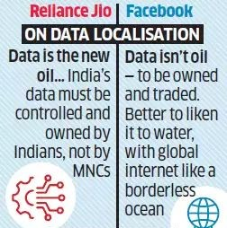
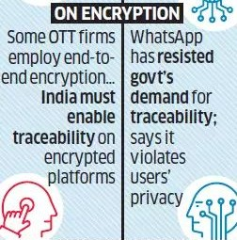
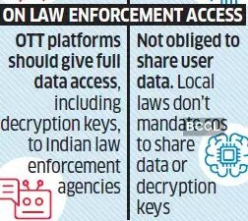
Third Contradiction Single Control v/s Multi-Control
Cyber sovereignty v/s Multiple stakeholders in governance.
cyber sovereignty will provoke controversy on the pattern of Internet Governance, i.e. sovereign government-led
governance will challenge the existing pattern of multi-party governance.
charrumalhotra[dot]iipa[at]gov[dot]in
7
The Jio- Facebook Deal
Facebook-Reliance Jio deal has to be evaluated closely due to potential implications for global tussle on data governance, & for politics on data sovereignty in the world’s largest democracy.
They have not been allies in the tumultuous geoeconomic debates shaping Indian cyber policy.
There are wide ranging disagreements between them over data localization, encryption & law enforcement access.
They have clarified -no data sharing agreement. There & specific areas of collaboration & of potential disagreement.
charrumalhotra[dot]iipa[at]gov[dot]in
8

Slide 5

The Implications & Possibilities of
the Deal
Facebook said intent of collaboration to enable new opportunities for the
millions of micro and small businesses.
This deal gives Reliance leverage in the e-commerce space as Reliance Retail’s Jio Mart can now connect local vendors with customers through Facebook-owned WhatsApp messaging platform.
This deal may help WhatsApp Pay which recently got a nod to operate in India by National Payments Corporation of India (NPCI).
The deal sparks concerns of unfair market competition and structural concerns for consumer welfare in India.
Big tech companies such as Facebook are uniquely placed to lead and effect changes in favor of user rights, given their global and pan-jurisdiction reach. These can be used either toward furthering or undermining the cause of democracy.
charrumalhotra[dot]iipa[at]gov[dot]in
9
References
●
●
Pinto, R. A. (2019). Digital Sovereignty or Digital Colonialism?. Sur
International Journal on Human Rights.
United Nations Human Settlements Programme. (2014). Urban Planning for
City Leaders. Retrieved from
https://www.local2030.org/library/67/Urban-Planning-for-City-Leaders.pdf
https://www.youtube.com/watch?v=_PoZ2Ddq96k
●
Kukutai, T., & Taylor, J. (2016). Data sovereignty for indigenous peoples:
current practice and future needs. ANU Press.
NEWS PAPER:
Mishra, D. (2020, June 19). Compliant with RBI’s data norms: WhatsApp. The
Times of India. Retrieved from https://timesofindia.indiatimes.com
charrumalhotra[dot]iipa[at]gov[dot]in
10

Slide 6


Our next session would be on :
Data Privacy & Data Protectio
Any questions?
You can find me at: Charrumalhotra[dot]iipa[at]gov[dot]in
charrumalhotra[dot]iipa[at]gov[dot]in 11

