Slide 1
Stream Name
Policy and Regulatory Framework for GovTech
Session Number: 02
Session Topic:
Drone Policy in India
CHARRU MALHOTRA, Ph.D. (IIT-D)
COORDINATOR ( Centre of e-Governance) Associate Professor (e-Governance and ICT) Indian Institute of Public Administration charrumalhotra [at]gmail.com
charrumalhotra[dot]iipa[at]gov[dot]in

Slide 2
Agenda
01
Timeline of Drones
02
Indian Drone Policy Direction
03
Night Operations of Drones
04
Key Highlights from the Policy
05
Some Uses of UAVs in Emergencies in the Past
06
Use of Drones During the COVID-19 Situation
07
Limitations Using Drones
08
Looking ahead: Cobotic Responses
09
Policy Gaps
2

Slide 3
Use of Drones for public service delivery
US Army vehicles ‘Kettering Bugs’
1930’
Radio Controlled aircrafts models by US and British
1990s
Source:PWC Report 2019, Data on wings

Slide 4
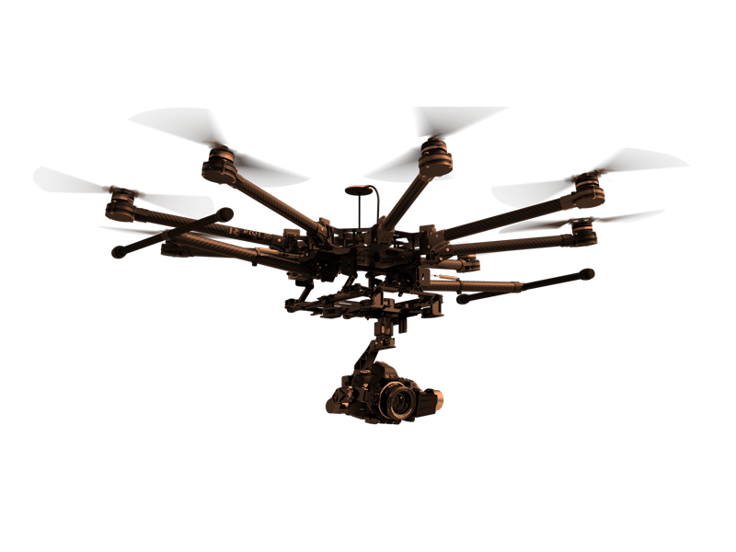
Indian Drone Policy Direction
Drone Policy 1.0 (October 2017)
Drone Policy 2.0
(August 2018)
Encompasses regulations for enhanced operations viz. flying beyond visual line of sight, commercial usage by way of cargo delivery and autonomous operations without active human intervention.
Essentially allowed hobbyists & recreational flyers to operate drones in the Indian airspace.

Slide 5
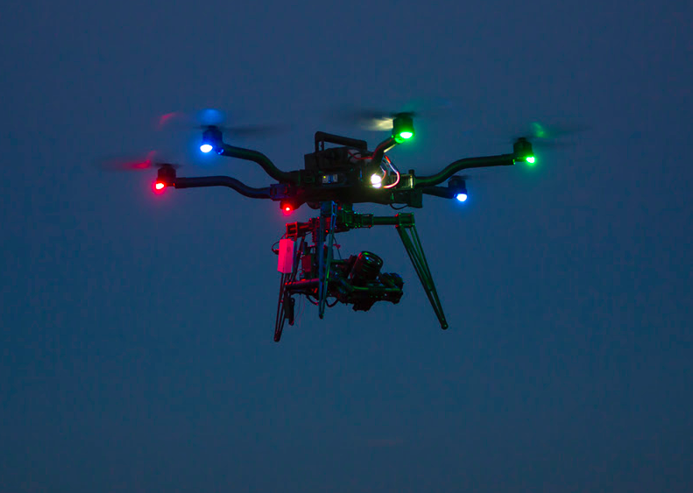
Night Operations of Drones
The policy further envisages allowing night operations of drone in India
The night operations are subject to operators having completed a proof of concept to the satisfaction of the concerned authorities.
Currently, night operation of a drone is a rare phenomenon across the world, it is allowed under drone policy 2.0

Slide 6
Key Highlights of the Drone Policy
Drones are classified into five segments based on their weight inclusive of payload.
All drones will have to be registered and provided with a Unique Identification Number (UIN) before they can be operated.
There will be a set of rules referred to as Civil Aviation Requirements (CAR) that all drones will have to adhere to depending on their classification.
All drones can only be flown by trained pilots.
Each drone is expected to be tagged and recorded with the data made available to the regulator on demand.
Source :https://www.pwc.in/consulting/financial-services/fintech/fintech-insights/data-on-wings-a-close-look-at-drones-in-india.html

Slide 7
Recommendations of Drone Policy 2.0
Beyond Visual Line of Sight (BVLOS) Operations: Expansion of operational airspace for drones operating beyond the visual line of sight and above the current limit of 400 ft.
Drone Corridor: A segregated airspace defined by the appropriate authorities in consultation with the airspace designers to keep commercial drones operations out of the non-segregated airspace in which manned aircrafts operate.
Autonomous Operations: The permission for use of algorithms for piloting may be given, only if adequate safety, security and privacy principles are demonstrated in the design of operations.
Airworthiness: New principles of air worthiness should be introduced to include safety by design, security by design and privacy by design.
Source : https://www.globalaviationsummit.in/documents/DRONE-ECOSYSTEM-POLICY-ROADMAP.pdf

Slide 8
Recommendations of Drone Policy 2.0 Contd…
UAS (Unmanned Aircraft System) Traffic Management :: A UAS Traffic Management should be responsible for managing UAS induced traffic, especially in the Drone Corridor.
Digital Sky Service Providers: DSPs would be engaged in providing enabled services to the UAS Operators, DigitalSky Platform, relevant law enforcement authorities and/or any other stakeholders.
Pilot Training:Improved and advance pilot training methods should be introduced to meet the professional requirements
Droneports:Designated areas dedicated to facilitate take-off and landing of the Drones
Payload / Cargo:Commercial drones operations will foster various new forms of air freight capabilities
Make in India : 100% FDI in UAS and RPAS-based commercial civil aviation services would provide a boost to the make in India initiative
Insurance: Considering the increased exposure due to commercial operations, it becomes important for UAS operators to have a professional liability insurance to cover the cost of legal fees and damages awarded against such operators

Slide 9
Applications of Drones
Drone-based applications
in India
Source:PWC Report 2019, Data on wings

Slide 10
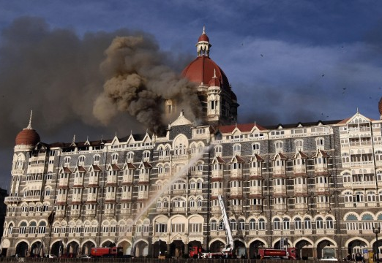
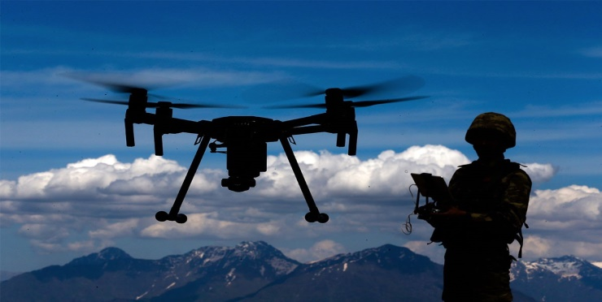
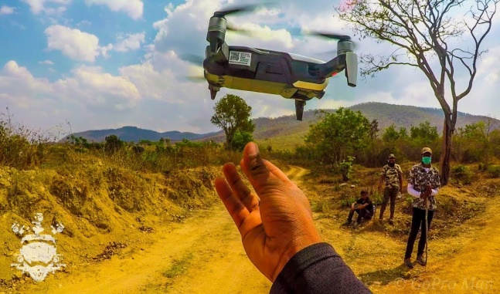
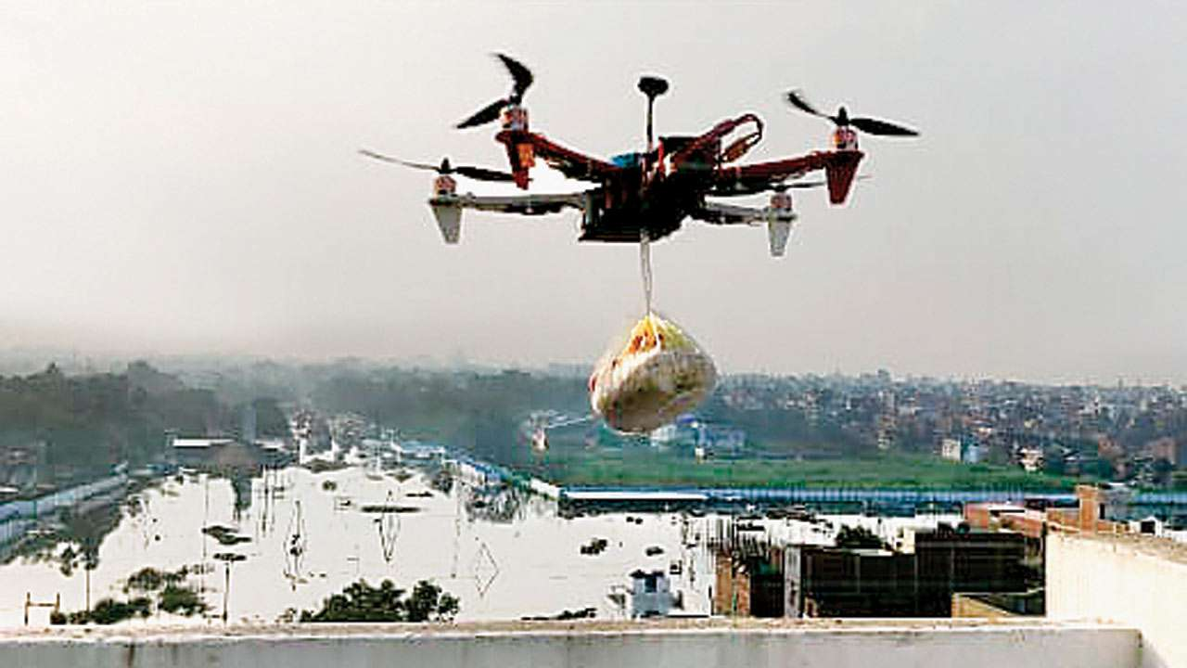
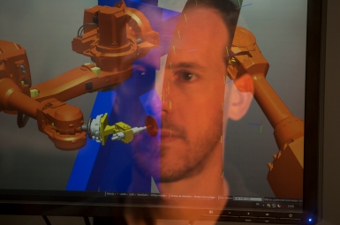
Use of Drones in Emergencies in the Past
2008
2016
2019
Pakistan-sponsored terror attack in Mumbai
Avalanche in Northern Siachen
Bandipur forest fires
2019
2019
Bihar floods
Cobotic Responses

Slide 11
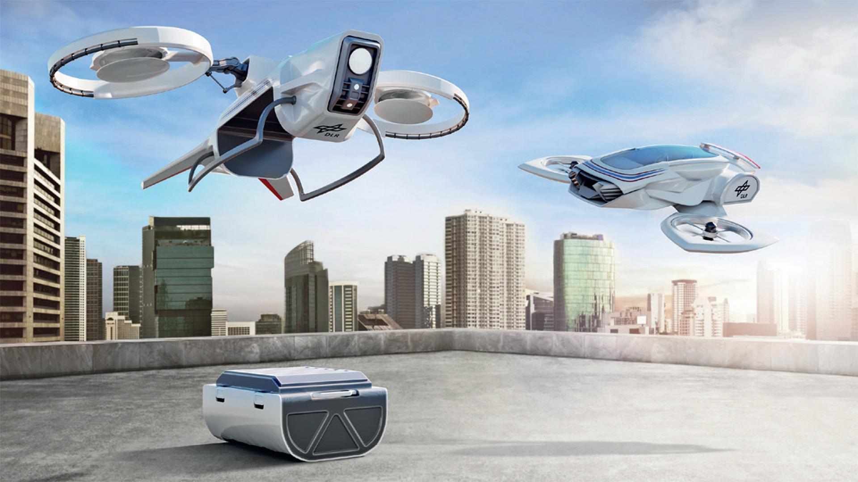
Is our drone policy in tune with the emerging scenario?

Slide 12
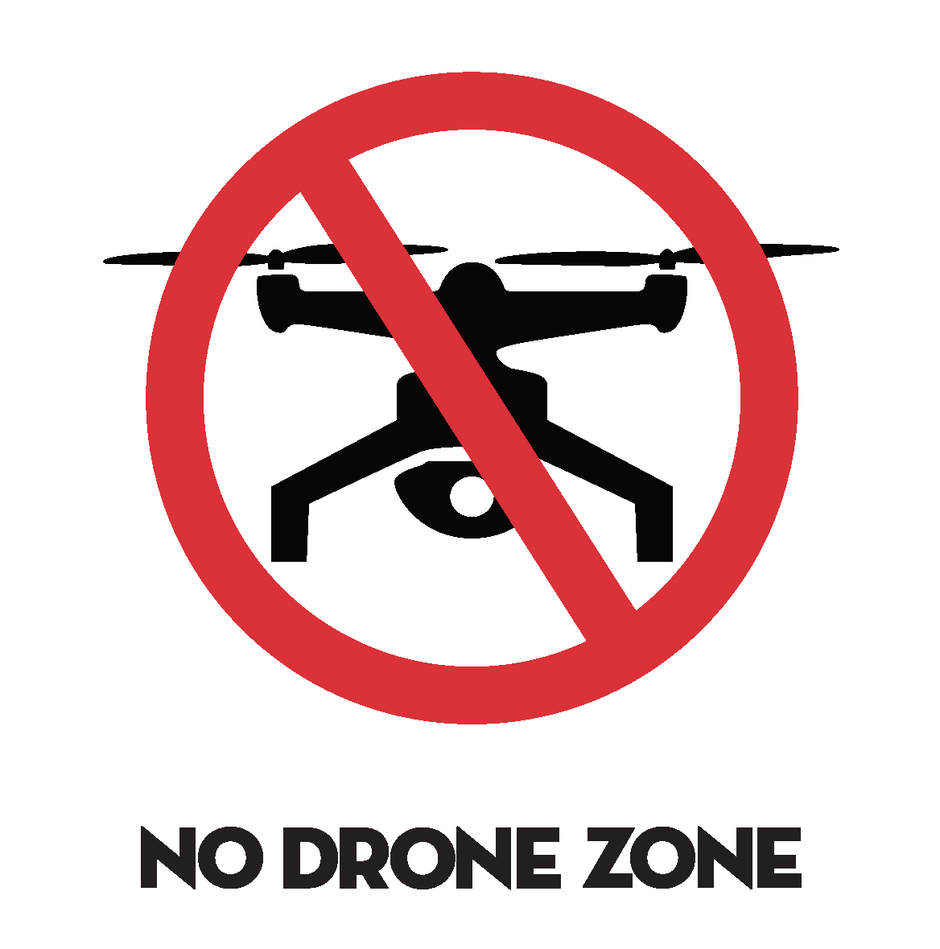
Limitations Using Drones
Flying permissions required every time
Issues of security- matter of concern
Violations of provisions may cancel/ suspend UIN
No Permission No Take Off- may limit usage of drones
New Application areas of Governance to be Permitted.

Slide 13
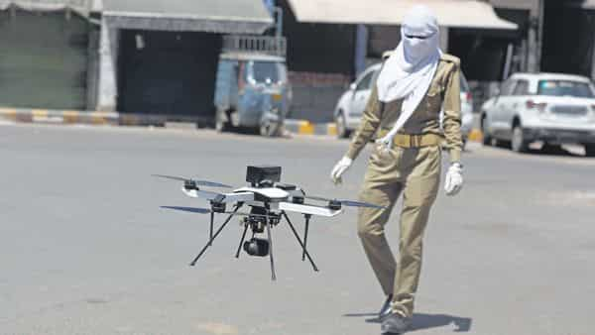
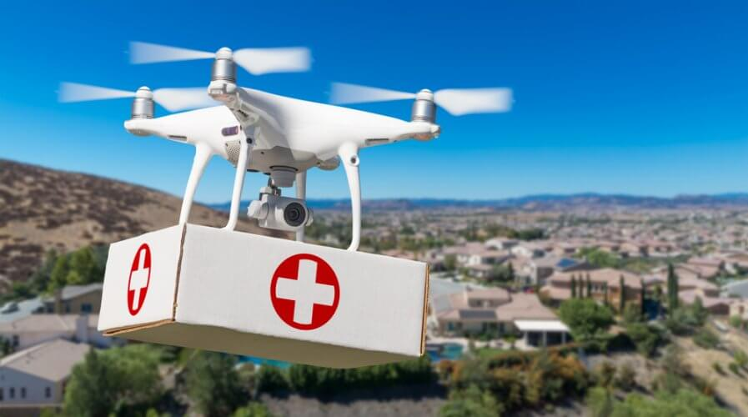
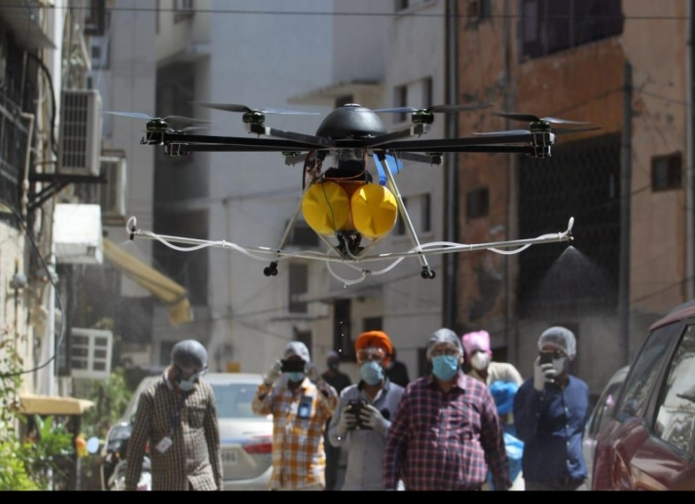
Use of Drone in Pandemic Scenario in 2020
Surveillance and monitoring during lockdowns
Broadcasting important messages
Tracking down violators of restrictions
Decontamination of hotspots
Delivery of medicines and some essential items

Slide 14
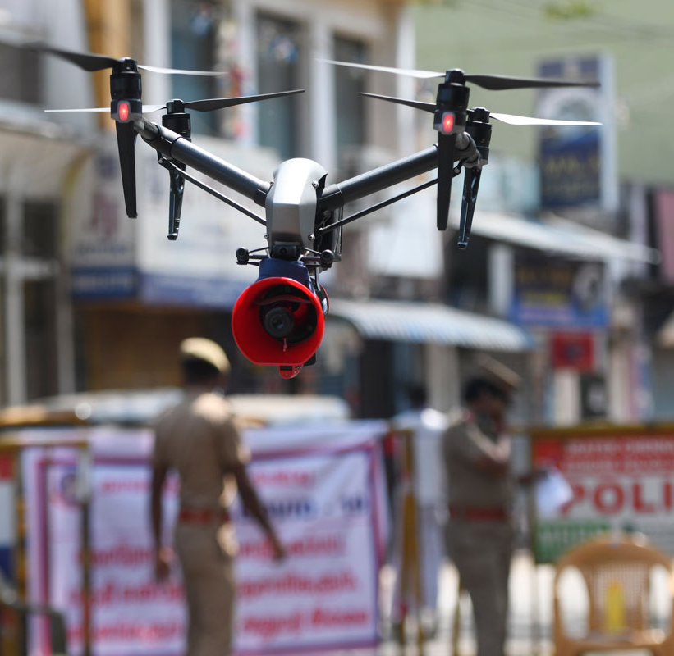
Conditional Exemption
To deploy drones at present, govt. agencies like the fire dept., police and NDMA need permission from the DGCA and AAI 24 hours in advance under the no permission no take-off (NPNT) regulation.
The emergency necessitates a faster response and cannot be predicted, these agencies should be exempted from NPNT.
For Example: Conditional exemption to Govt. entities for COVID-19 related RPAS operation through public notice of May 2, 2020

Slide 15
Looking Ahead: Machines as Co-workers
(Cobotic Responses)
Integration of Drones in the emergency response systems called “cobotic responses”, in which humans cooperate with robots (effectively drones are robots).
Uses:
Detection and resolution like Fukushima nuclear accidents
Police using Drones with attached sirens and loudspeakers to warn residents to stay home
Delhi-based company is using drones to disinfect areas specified by SDMC
Conditional Exemption for emergency response for Govt entities like in COVID-19 case

Slide 16
Regulations by Country
BVLOS: Beyond Visual Line of Sight
Source:PWC Report 2019, Data on wings

Slide 17
Policy Gaps
Quality Control : The lack of policy on quality control and standardisation for both indigenously manufactured and imported drones presents several challenges
Standard Operating Protocol for Incidents: There has been no protocol formulated by authorities for incident management in the event of an accident.
For e.g. in 2015, an unidentified man was spotted flying a drone close to the residence of the President and the Indian Parliament
The Privacy Question: The Indian government has so far made no attempt to address concerns of privacy infringement by drones

Slide 18
Policy Gaps Contd…
Terrorist Threat Management: Policymakers and security agencies should be prepared with threats posed by drones, as there are several instances of terrorist organisations using drones to carry out their activities
Air Traffic Management: There is need for the development of collision avoidance system for drones, so that a drone can sense if an object is in front of it and is able to change its flight path.
Legal Liability: As per the policy the legal responsibility of drones is on their operators. The assumption is that the operator would ensure that the vehicle is airworthy and is functioning as expected. However, this might not always be the case

Slide 19
References/Further Reading
Flying into the hurricane: A case study of UAV use in damage assessment during the 2017 hurricanes in Texas and Florida (Greenwood) : https://doi.org/10.1371/journal.pone.0227808
Implementing Drone Tech as Governments : https://www.pwc.in/industries/government-and-public-sector/preparing-for-takeoff.html
Drones for Delivering Results for Children : a UNICEF casestudy : https://www.unicef.org/evaldatabase/files/5._EOI_Case_Study_Drones_for_Delivering_Results_for_Children.pdf
Drones, drone strikes, and us policy: The politics of unmanned aerial vehicles (a paper by Ulrike Esther Franke)
Drone Laws of India Explained : https://www.youtube.com/watch?v=PmFUDAb9GXQ

Slide 20
Our next session would be on :
IoT Policy: India and Global Scenario
Any questions?
You can find me at:
Charrumalhotra[dot]iipa[at]gov[dot]in

