Slide 1
Disaster Management Act- 2005
Prof. Vinod K. Sharma
Indian institute of public administration, new delhi

Slide 2
Disaster Management Act 2005
Enacted at 26th December, 2005
Comprising of 79 sections and 11 chapters
Defines disaster and disaster management and its concept
Provides institutional mechanism for monitoring and implementation of plans
Ensures measures for the prevention and mitigation of disasters

Slide 3
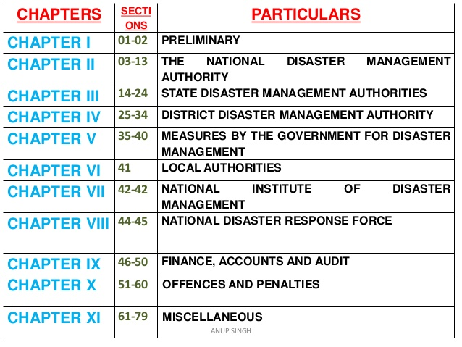

Slide 4
Levels of Disaster Management Planning
National
District
Local
State

Slide 5
Disaster Management Authorities
NDMA
SDMA
DDMA

Slide 6
NDMA
Apex statutory body for disaster management in India
General Structure
Chairman: The prime Minister of India
Vice-Chairman
Four Members, Member Secretary
Skills and expertise of the specialists are extensively used to address disaster related issues
Visions: To build a safer and disaster resilient India by a holistic, proactive, technology driven and sustainable development strategy that involves all stakeholders and fosters a culture of prevention, preparedness and mitigation.

Slide 7
Functions of NDMA
Lay down policies on Disaster Management
Approve the national plan
Approve plans made by Ministries and Depts. of Govt. of India
Make guidelines for State Authorities
Make guidelines for Depts. & Ministries
Coordinate enforcement and implementation of the policy and plan etc.
Recommend provision of funds for mitigation
Provide support to other countries
Capacity building; Make policies for NIDM

Slide 8
SDMA
Chaired by Chief Minister
It will be responsible for laying down the policies and plans for disaster management in the state
Recommend guidelines for providing minimum standards of relief
Assisted by State Executive Committee
State Level
Coordination
Preparedness
Resource Mobilization

Slide 9
DDMA
Section 25 of the DM Act provides for constitution of DDMA for every district of a state.
The District Magistrate/ District Collector/Deputy Commissioner heads the Authority as Chairperson besides an elected representative of the local authority as Co-Chairperson except in the tribal areas where the Chief Executive Member of the District Council of Autonomous District is designated as Co-Chairperson.
Further in district, where Zila Parishad exists, its Chairperson shall be the Co-Chairperson of DDMA.
Responsible for planning, coordination and implementation of disaster management and to take such measures for disaster management as provided in the guidelines.
Has the power to examine the construction in any area in the district to enforce the safety standards and to arrange for relief measures and respond to the disaster at the district level.

Slide 10
National Disaster Response Force (NDRF)
A unit by government body created for the purpose of specialized response to natural and man-made disasters
Is one of its kinds as it is the single-largest dedicated disaster response force in the world
The section 44-45 of the Act provides for constituting a NDRF “for the purpose of specialist response to a threatening disaster situation or disaster” under a Director General to be appointed by the Central Government

Slide 11
NIDM
Constituted under an Act of Parliament with a vision to play the role of a premier institute for capacity development in India and the region
Support to various National and State level agencies in the field of Disaster Management & Disaster Risk Reduction.
Its vision is to create a Disaster Resilient India by building the capacity at all levels for disaster prevention and preparedness.

Slide 12
Disaster Management Cycle
A holistic and integrated approach will be evolved towards disaster management with emphasis on building strategic partnerships at various levels. The themes underpinning the policy are:
Community based DM, including last mile integration of the policy, plans and execution.
Capacity development in all spheres.
Consolidation of past initiatives and best practices.
Cooperation with agencies at national and international levels.
Multi-sectoral synergy.

Slide 13
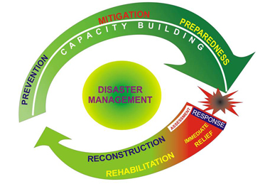
Phases of Disaster Management Cycle
The entire disaster management cycle is divided into four phases:
Mitigation - Minimizing the effects of disaster. Examples: building codes and zoning; vulnerability analyses; public education.
Preparedness - Planning how to respond. Examples: preparedness plans; emergency exercises/training; warning systems.
Response - Efforts to minimize the hazards created by a disaster. Examples: search and rescue; emergency relief .
Recovery - Returning the community to normal. Examples: temporary housing; grants; medical care.

Slide 14
1. Mitigation
Structural Mitigation
Construction projects which reduce economic and social impacts i.e. dams, windbreaks, terracing and hazard resistant buildings
Non- Structural Mitigation
Policies and practices which raise awareness of hazards or encourage developments to reduce the impact of disasters

Slide 15
1. Mitigation
Reviewing building codes
Vulnerability analysis updates
Zoning and land-use management and planning
Reviewing of building use regulations and safety codes
Implementing preventative health measures
Political intervention and commitment
Public Awareness

Slide 16
Preparedness
Preparedness Plans
Emergency exercises/ training
Warning Systems
Emergency communications systems
Evacuation plans and training
Resource inventories
Emergency personnel/ contact list
Mutual aid agreements
Public information/education

Slide 17
Response
Addresses immediate threats presented by the disaster, including saving lives, meeting humanitarian needs (food, shelter, clothing, public health and safety), cleanup, damage assessment, and the start of resource distribution.
Rescue efforts
First aid treatment
Fire fighting
Monitoring of secondary disaster
Construction of temporary housing
Establishment of tent villages

Slide 18
Recovery
4 R’S
Rescue,
Relief,
Rehabilitation
Reconstruction
Disaster resistant reconstruction
Appropriate land use planning
Livelihood support
Industrial rehabilitation planning

Slide 19
Further Readings:
https://www.ndmindia.nic.in/images/The%20Disaster%20Management%20Act,%202005.pdf
https://nidm.gov.in/about.asp
https://www.adrc.asia/publications/TDRM2005/TDRM_Good_Practices/PDF/PDF-2005e/Chapter2_2.2.pdf
https://ndma.gov.in/en/hazard-risk-mitigation.html

Slide 20
THANK YOU

