Slide 1
Public Health Infrastructure in Rural India
Issues and Challenges
Dr. Amit Kumar Singh
IIPA, New Delhi

Slide 2
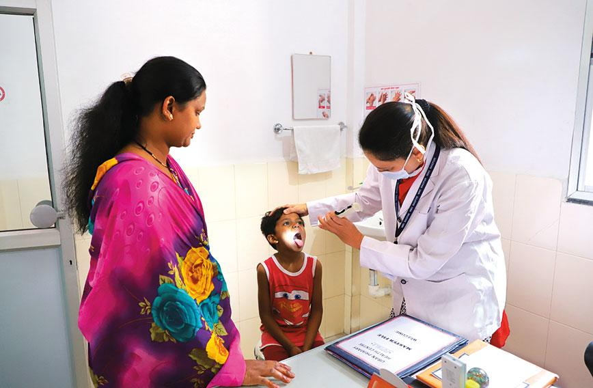
Slide Title
Introduction
Access to good health is a basic human right.
Availability of health services is important for promoting and maintaining good health, preventing and managing disease, reducing unnecessary disability and premature death,
Healthy people makes an important contribution to economic growth, as they live longer, are more productive, and save more.

Slide 3
Slide Title
Introduction
A close observation of country’s health care system indicates that Indian health care is facing a deep rooted crisis in rural areas.
Government succeeded in generating good health infrastructures in urban area but fail to do so in rural areas.
Looking at the health landscape of India, 75 per cent of health infrastructure and other health resources are concentrated in urban areas and most of the health resources lie with the urban centric private sector.
Rural areas constitute about 65% of the population in 2016, only 36% of health workforce was available in rural areas

Slide 4
Slide Title
Introduction……………
India has a little over one million modern medicine (allopath) doctors to treat its population of 1.3 billion people. Of these, only around 19% work in the public health sector.
The density of qualified health workers was 22.7 per 10,000 population in urban areas, as compared to 3.0 per 10,000 population in rural areas.
Only 32% of all government hospital beds are available in rural areas and rests of the 68% beds were available in urban areas.
The present health scenario is due to lethal combination of poverty, uneven distribution of health care, high cost and limited access for poor & marginalized population.

Slide 5
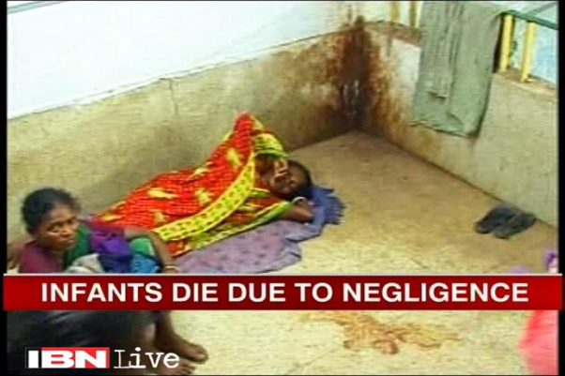
Slide Title
Challenges of Rural Health Care
850 million people lives in rural areas where the condition of medical facilities is deplorable.
Challenges for Rural India
Lack of quality health care infrastructure
Shortage of qualified medical functionaries
Limited access to hospitals & basic medicines
Absence of diagnostic centres
Poor living conditions for health workers
High Pop Growth & Substantial poverty
Lack of sanitation, hygiene & awareness

Slide 6
Slide Title
Health Policies in India
To meet these challenges Government at the Centre as well as of the States have implemented various health schemes
Reproductive, Maternal, Newborn, Child and Adolescent Health (RMNCH+A)
Rashtriya Bal Swasthya Karyakram (RBSK)
Janani Shishu Suraksha Karyakaram
Revised National TB Control Programme
Pradhan Mantri Swasthya Suraksha Yojana (PMSSY)
Integrated Child Development Service
Rashtriya Swasthya Bima Yojana
National Rural Health Mission (NRHM)

Slide 7
Slide Title
National Rural Health Mission (2005)
Objective of the mission was to provide, accessible, affordable, effective, accountable, and reliable health care to the entire rural population in the country with special focus on 18 states (8 North Eastern states + 8 empowered action group (EAG) states [socioeconomically backward states.,

Slide 8
Slide Title
NRHM – Salient features
The expected outcomes
To reduce IMR to 30/1000 live births by 2012.
Maternal Mortality reduced to 100/100,000 live births by 2012.
TFR reduced to 2.1 by 2012
Core strategies of the Mission
Train and enhance capacity of Panchayati Raj Institutions (PRIs) to own, control and manage public health services.
Promote access to improved healthcare at household level through the female health activist (ASHA).
Strengthening sub-centre through better human resource development
Strengthening existing (PHCs) through better staffing and human resource development policy.
Provision of 30-50 bedded CHC per lakh population for improved curative care to a normative standard.

Slide 9
Slide Title
Healthcare Infrastructural System in Rural India -NRHM
Healthcare in India’s villages is a three-tiered structure under the National Rural Health Mission (NRHM)
Sub-centres (SCs)
Primary Health Centres (PHCs) and
Community Health Centres (CHCs)
NRHM also have made provision of trained female community health activist at village level- ASHA

Slide 10
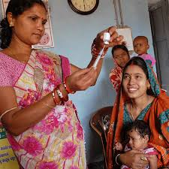
Slide Title
ASHA (Accredited Social Health Activist)
ASHA (Accredited Social Health Activist) is a trained female community health activist. Selected from the community itself and accountable to it, the ASHA is trained to work as an interface between the community and the public health system.
The ASHA’s role
Identifying and registering new pregnancies, births and deaths
Mobilizing, counseling and supporting the community to demand and seek health services
Identifying, managing or referring cases of illness
Supporting health service delivery through home visits, first-aid and immunizations sessions
Maintaining data and participating in community-level health planning

Slide 11
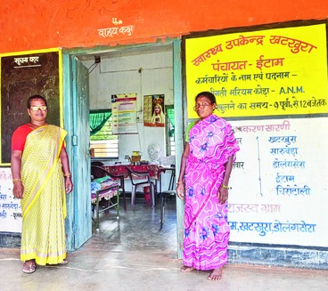
Slide Title
Sub Centre (SC)
The Sub Centre is the most peripheral and is point of first contact between the primary healthcare system and the rural community.
The Ministry of Health & Family Welfare is providing 100% grant
They are established on the basis of
One SC for every 5,000 pop in general and…
One SC for every 3,000 pop in hilly, tribal and backward areas
Each SC Manned by one female and one Male Health Worker.
There were 1, 56,231 Sub Centres functioning in the country as on 31st March, 2017.

Slide 12
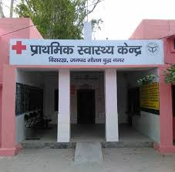
Slide Title
Primary Health Center (PHC)
PHC is the first contact point between village community and the Medical Officer.
The PHCs are established and maintained by the State Governments.
At present, a PHC is manned by a Medical Officer supported by 14 paramedical and other staff.
It acts as a referral unit for 6 Sub Centres.
Provision of 4 - 6 beds for patients.
One PHC for every 30,000 pop in Rural areas

Slide 13
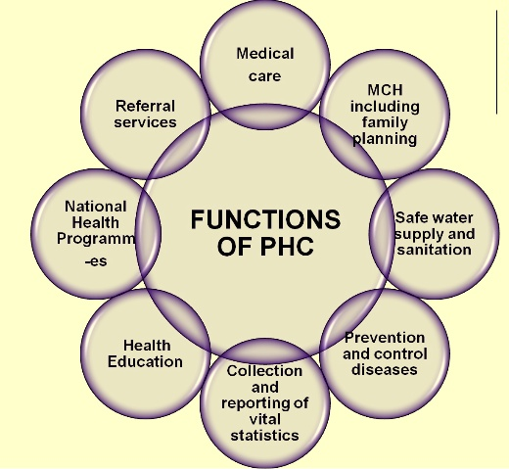
Slide Title
Functions of PHCs
Medical care
Health programmes
MCH care and family planning
Health education and training
Referral services
Safe water supply and basic sanitation
Prevention and control of locally endemic diseases
Collection and reporting of vital events
Basic laboratory services

Slide 14
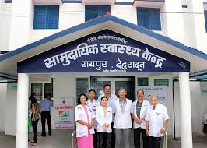
Slide Title
Community Health Center (CHC)
CHCs serves as a referral centre for PHCs and also provides facilities for obstetric and specialist consultation.
Each community health center should cover a population of 80000 to 1.2 lakh
It is manned by four medical specialists i.e. Surgeon, Physician, Gynecologist and Pediatrician and supported by paramedical and other staff.
It has 30 in-door beds with one OT, X-ray, Labour Room and Laboratory facilities.
Care of Routine and Emergency Cases in Medicine & Surgery
4 ANC check ups & 24 hr delivery services including normal and assisted delivery and cesarean section

Slide 15
Slide Title
Progress in Health Indicators
Infant mortality also fell from 91 in 2000 to 32
Maternal mortality has fallen by almost 65 per cent since 2000
There has been 60 % increase in CHCs, 8 % in SCs and 7 % in CHCs
It has also placed at least one ASHA worker in every village of India.
Janani Shishu Suraksha Karyakram - Overall, 75% of rural births are now supervised, as compared to 89% of urban deliveries.
Selected Indicators | 2000 | 2016
Infant Mortality Rate | 91 | 32
The Total Fertility Rate (TFR) | 2.9 | 2.1
Maternal Mortality Ratio (MMR) (per 100000 live births) | 374 | 130
HW (F) | 133194 | 234220
Allopathic doctors at PHCs | 20308 | 29799
Sub –Centres | 146026 | 156231(2017)
Primary Health Centres | 23236 | 27124 (2017)
Community Health Centres | 3346 | 5624 (2017)

Slide 16
Analysing Rural Health Care Infrastructure
There may be a lot of work has been done on improving rural healthcare in India but, going by the different reports, healthcare in rural areas remained a concern.
Till today, rural India has not been able to overcome the shortage of specialist doctors at PHCs and CHCs level.
To analyse the present condition and challenges of rural health sector, there is need to assess the healthcare facility on the basis of their Availability, Accessibility, Affordability and Acceptability
Availability
Affordability
Accessibility
Acceptability

Slide 17
Slide Title
Population Pressure on Rural Health Care System
As per IPHS norms, a sub-centre is supposed to serve 3,000-5,000 people; a PHC is supposed to serve 20,000-30,000 people, and for CHC it is 80,000 to 1,20,000.
However, according to RHS, the average population served per sub-centre in the country is 5616. The number is 35567 for PHCs, and 165702 for CHCs.
Health Facility | Population Norms |  | Average rural population covered
 | Plain Area | Hilly Area
Sub-Centre | 5000 | 3000 | 5616
Primary Health Centre | 30,000 | 20,000 | 35,567
Community Health Centre | 1,20,000 | 80,000 | 1,65,702

Slide 18
Slide Title
Population Pressure on Rural Health Care System
In the 5,624 CHCs, there is a requirement of 22,496 specialists. However, the shortage of specialists is 81.89%, that is, the CHCs across the country lack 18,422 doctors.
Highest shortfall was found for physicians (85.72 %)
Shortfall for Surgeons 84.58%,
82.61% for paediatricians and,
and 74.68% for obstetricians and gynaecologists.
The CHCs also have a requirement of 5,624 radiographers, out of which, only 2,128 are in position, causing a shortfall of 64.7%.

Slide 19
Slide Title
Adequacy of Health workers at PHCs
As on 31st March 2019, 9.6% PHCs are without a doctor, 33.4% are without a Lab Technician and 23.9% are without a pharmacist
For Health Assistant (Female)/LHV, the shortfall is 47.9% and for Health Assistant (Male) shortfall is 59.8%.

Slide 20
Slide Title
Shortfall of Health workers at SCs
9.2% of the Sub Centres are without a Female Health Worker/ ANM
54.2% Sub Centres are without a Male Health Worker.
3.8% Sub Centres are without both Female Health Worker/ ANM as well as Male Health Worker

Slide 21
Slide Title
Availability of Health workers in Rural Areas
Rural-Urban Distribution Of Health Workers, 2016
World Health Organization (WHO) 2016 report indicates about the huge shortage of health workers in Rural India.
75 per cent of health infrastructure and other health resources are concentrated in urban areas.
Rural India with little access to healthcare workers
64% of the country’s 2-million strong health workforce caters to urban India, only the remaining 36% services villages.
Source: The Health Workforce in India 2016,World Health Organisation

Slide 22
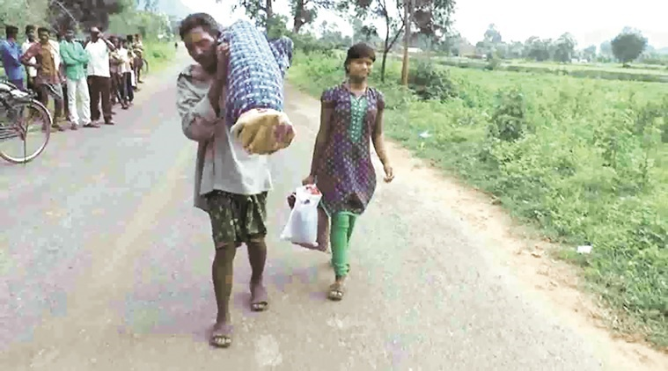
Slide Title
Inaccessible Rural Health Care System in India
Considering the condition of public transport in the rural area, to reach a distantly located hospital, is still a difficult task for a villager.
To reach a CHCs, rural people have to cover an average distance of 13.65 km.
Dana Majhi, a tribal man from Kalahandi carried his wife’s body on his shoulders for nearly 12 km as he had no money for a hearse van.

Slide 23
Slide Title
Geographically skewed distribution of healthcare doctors
A.P, Karnataka, Kerala , Maharashtra and Tamilnadu | Bihar, MP, Rajasthan and UP
30 % of Population | 37 % of Population
55% share of Medical Colleges | 15% share of Medical Colleges
30% share of ANM nursing Colleges | 20% share of ANM nursing Colleges
States like Bihar, UP, MP and Rajasthan owns 37% of India’s population, but they have only 15 % of Medical Colleges

Slide 24
Slide Title
Major source of financing the hospitalization expenses
Percentages share of hospitalization cases in India
The poor are routinely forced to dip into their savings, borrow, delay treatment or receive poor quality care, experts said.
The average medical expenditure incurred during stay at hospital per case of hospitalization is 7.5 time higher for private hospitals as compare to govt. hospitals
Private hospitals gets 51.9 % of rural hospitalization cases and 61.4 % of urban cases. areas government hospitals
Source: NSS 75th Round (July 2017 – June 2018)
Average medical expenditure per hospitalisation case by type of hospital

Slide 25
Slide Title
Major source of financing the hospitalization expenses
Break-up (%) of hospitalization cases by major source of finance of expenses
Households having persons who had been admitted to hospital during the last 365 days were asked about the major source of financing the hospitalization expenses.
The responses were classified into five categories, namely, (i) household income/savings, (ii) borrowings, (iii) sale of physical assets, (iv) contribution from friends and relatives, and (v) other sources.

Slide 26
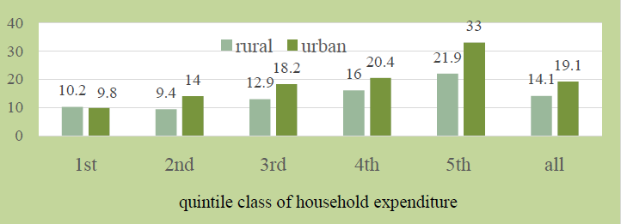
Slide Title
Insurance Coverage
Percentages of persons having health expenditure coverage
Till today less than 15% of the rural people have any kind of health insurance, forcing them to spend Out of Pocket for healthcare expenses, report by the National Survey Office (NSO).
Health costs keep people poor, and push those just above the poverty line back into poverty. In 2011-12, out-of-pocket health expenses drove 55 million Indians into poverty trap.

Slide 27
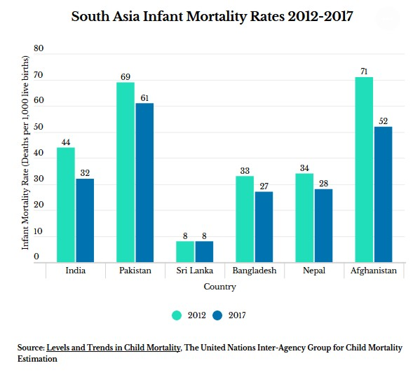
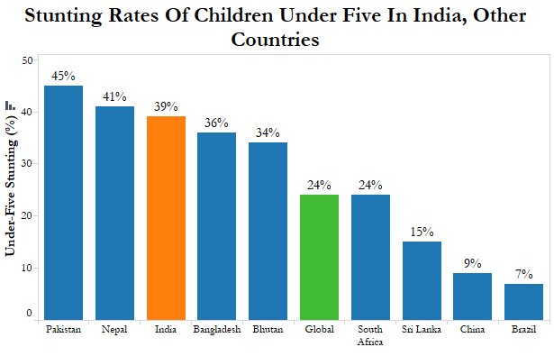
Comparative Analysis with Neighbours

Slide 28
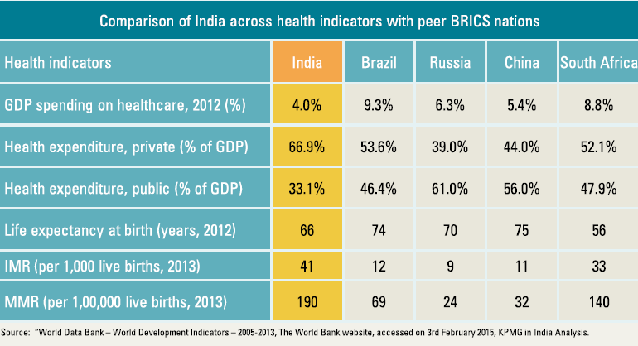
Expenditure on Health care system – a Comparative Analysis

Slide 29
Slide Title
Way forward
Strengthening of Rural Health Infrastructure
Augmenting infrastructure and facilities at SCs/PHCs/CHCs
Increase the number of qualified Doctors in Rural Areas ( problems of quack doctors)
It will help to prevent many life-threatening diseases through timely diagnosis and medication.
It will not only reduce the burden on secondary and tertiary care system
Ensuring the presence of Doctors & Other Para Medical Staffs in rural hospitals:
Retention of doctors in rural areas is a major challenge.
Poor living and working conditions, irregular medicine supply, professional isolation and the burden of administrative work are some of the challenges faced by doctors on rural postings.
As per the World Bank 2011 study 39% medical providers in PHCs in 19 major states were counted “absent”.

Slide 30
Slide Title
Way forward….
Increase public health expenditure
Spending on public health care must be increase to 2.5 % of GDP care. At present it is 1.41 % of GDP, placing India below Pakistan, China and Nigeria in the spending table.
The allocation to NHM declined from 57% of the health budget in 2016-17 to 56% in 2017-18–despite an absolute increase from Rs 22,197 crore to Rs 26,690 crore.
Despite that 14 states lose on at least 20% of National Health Mission funds over non-performance
Need to reduce Out of Pocket Expenses
Very high out-of-pocket (OOP) expenditure for the general public. 78% of all spends on healthcare are paid by the people and 72% of this is on drugs alone.
About 23% of the sick can’t afford healthcare because of these payments- WHO
The Pradhan Mantri Jan Arogya Yojana should be extended to the 10 crore poor families on priority basis

Slide 31
Slide Title
Way forward…..
Establishment of Pradhan Mantri Bhartiya Janaushadhi Kendras
70 percent of the overall household expenditure on health in the country is on medicines. Source: WHO
Recently government has reduced the price of 348 essential medicines by Introducing Drug Price Control Order. Now more drugs shall be included in this category.
Health and Wellness Centres (HWCs)
Under the Ayushman Bharat GoI has decided to create 1,50,000 Health and Wellness Centres to deliver Comprehensive Primary Health Care that is universal and free to users, with a focus on wellness and the delivery of an expanded range of services closer to the community.
Making Swachh Bharat Mission Successful (SBM-Rural)

Slide 32
Slide Title
Further Readings
Bhandari L. & Dutta S. (2007): ‘Health Infrastructure in Rural India’ in India Infrastructure Report; 2007, available from http://citeseerx.ist.psu.edu/viewdoc/download?doi=10.1.1.463.4188&rep=rep1&type=pdf
Saikia, D. (2017): ‘Human Resource Challenges in the Public Health Sector in Rural India’ in The Journal of Institute of Public Enterprise, Jan-June, Vol. 40, No. 1&2 ISSN : 0971-1864.
National Health Profile 2018 13th Issue , published by Central Bureau of Health Intelligence Directorate General of Health ServicesMinistry of Health & Family Welfare, Government of India, available from http://www.cbhidghs.nic.in/WriteReadData/l892s/Before%20Chapter1.pdf
Kumar A. & Gupta S. (2012): Health Infrastructure in India: Critical Analysis of Policy Gaps in the Indian Healthcare Delivery, Occasional Paper, Published by Vivekananda International Foundation, July – 2012, available from https://www.vifindia.org/occasionalpaper/2012/health-infrastructure-in-india-critical-analysis-of-policy-gaps-in-the-indian-healthcare-delivery

Slide 33
Slide Title
Thank You

