Slide 1
Infrastructure and Rural Development
in India
Dr. Amit Kumar Singh
IIPA, New Delhi

Slide 2
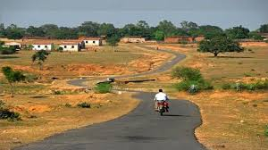
Slide Title
Introduction
India is predominantly a rural country.
Over 2/3rd (66 %) of the total population lives in rural areas, The development of rural areas is an imperative for inclusive and equitable growth of India.
More than 70 per cent of the country’s poor lives in rural areas.
The rural poverty cuts across states and it is very much related with lack of access to productive assets such as land, water, and other natural resources and social assets such as extension services, education and basic healthcare to the common rural people.

Slide 3
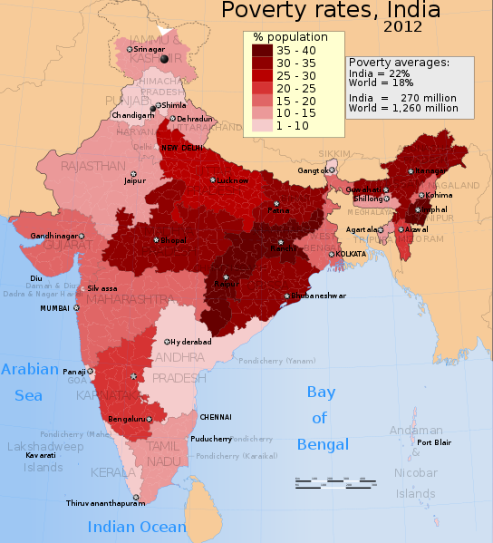
Slide Title
Cont….
Infrastructure - Basic services without which primary, secondary and tertiary productive activities cannot grow.
Typically, rural infrastructure in the country encompasses rural roads, major dams and canal works for irrigation and drainage, rural housing, rural water supply, rural electrification and rural telecommunication connectivity, agriculture market.
The analysis of incidence of poverty across Indian States indicates that rural poverty is very closely linked to the areas which have acute shortages of social and physical infrastructure.

Slide 4
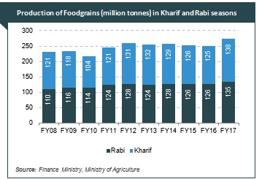
Cont…
Rural infrastructure is crucial for agriculture, agro-industries and overall economic development of rural areas.
In rural India, Agriculture is still the major source of livelihood.
Indian agriculture is still not well linked with the rest of the economy through improved infrastructure and integrated markets.
Agricultural sector have been stagnant since last many years.

Slide 5
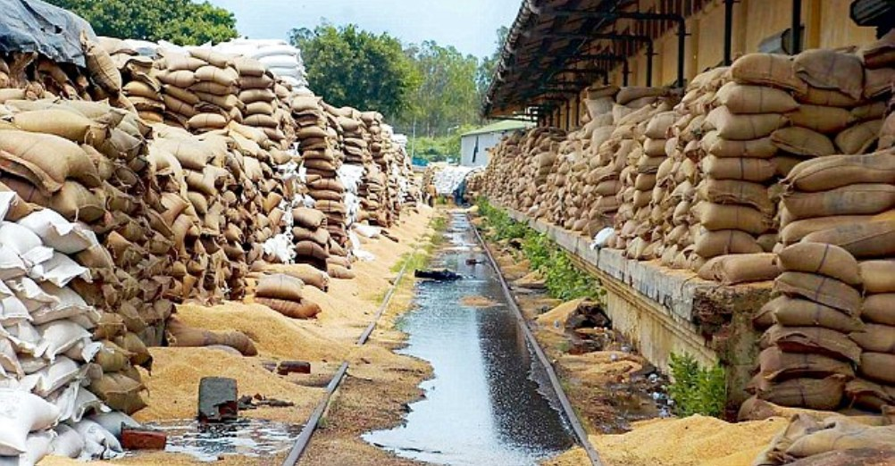
Introduction……..
Rural infrastructure leads to agricultural developments by increasing yields, storage, farmers’ access to markets and availability of institutional finance.
It is estimated that 16 per cent of the fruits and vegetables is lost between the farm gate and the consumer due to lack of cold chain and proper storage facility, exports, transportation, adequate processing facilities, and marketing, adversely influencing the income of farmers (Financial Express, July 31, 2019).

Slide 6
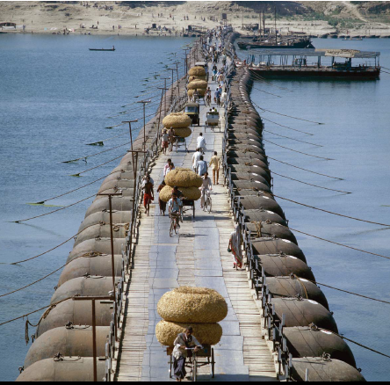
Infrastructure for Integrated development
For Integrated development, rural areas requires the rapid growth of non-farm economic activities and opportunities for employment, especially through rural industries.
Poor rural infrastructure also limits the ability of the traders to travel to and communicate with remote farming areas, limiting market access from these areas and eliminating competition for their produce.

Slide 7
Cont…
Rural India generally lagged behind urban areas in terms of development and the overall progress of the economy, many reasons can be stated for this;
Geographical adversity
Enforcement of Law & Order
Deep-rooted socio-economic stratification
Lack of basic infrastructure
States’ Economic Conditions
Public health and sanitation
Concentration of poverty in pockets

Slide 8
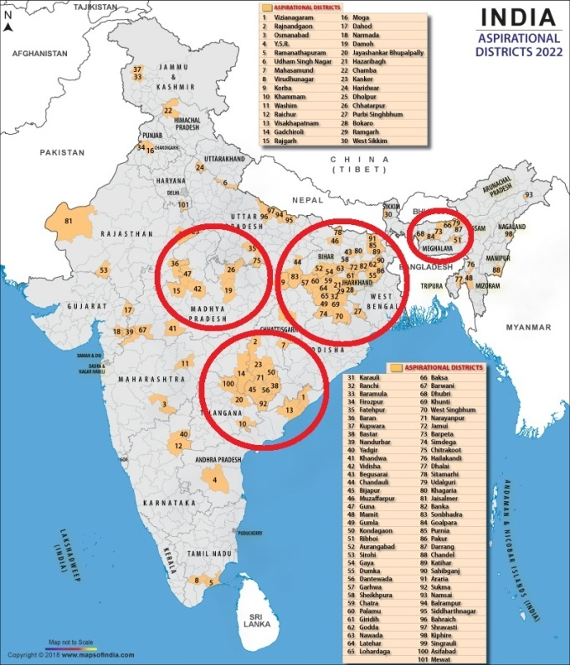
Rural Infrastructure and Aspirational Districts’ Programme
Recently, Niti Aayog have identified the 115 most backward districts, including 35 affected by left-wing extremist violence.
It is not that there has been no development in these districts, but the relative backwardness has not changed much over the decades. Even till today, by and large they still remain the most backward among India’s 700-plus districts.
Why has their relative backwardness not changed over the decades.
Aspirational Districts of India

Slide 9
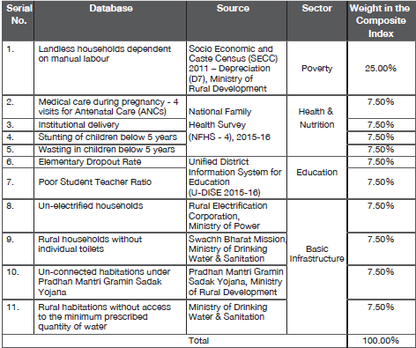
Cont……
Aspirational Districts are those districts in India, that are affected by poor socio-economic indicators.
Selection of AD is based on a Composite Index developed with 5 core sectors data, namely Poverty, Health and nutrition Education, and Basic Infrastructure.
As a whole, different infrastructure and basic amenities have been given the maximum weight in the Composite Index

Slide 10
Cont……
Backwardness is complex issue. It involves historical, demographic, social, economic and political factors which have been existed since decades.
Backward districts suffer from poor connectivity and are chronically vulnerable to natural calamities. Scheduled Castes and Tribes and minorities who constitute the bulk of the country’s backward population are concentrated in these districts.
They lack infrastructural and institutional capacity of delivery of public services, consequently remains backward and their people remain trapped in a vicious circle in which lack of infrastructure and economic activity feed each other.

Slide 11
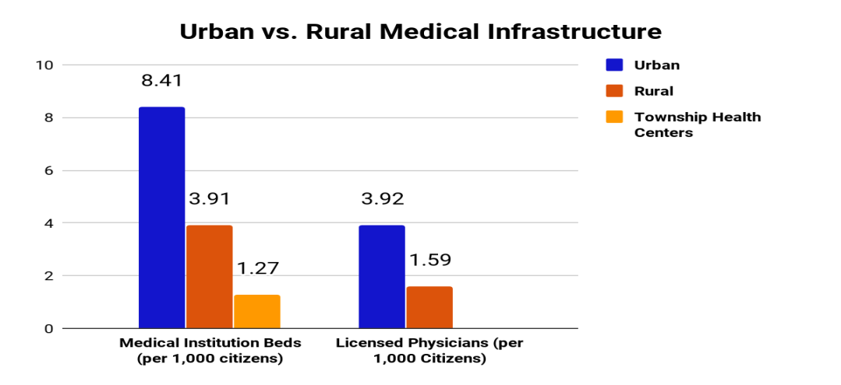
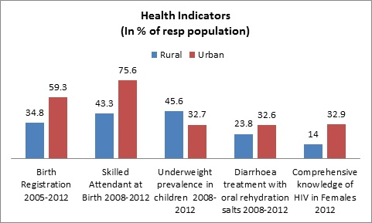
Selective Indicators

Slide 12
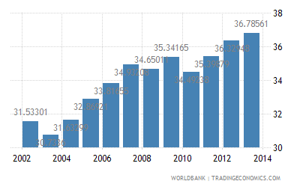
Selective Indicators………..
India – % Agricultural Irrigated Land

Slide 13
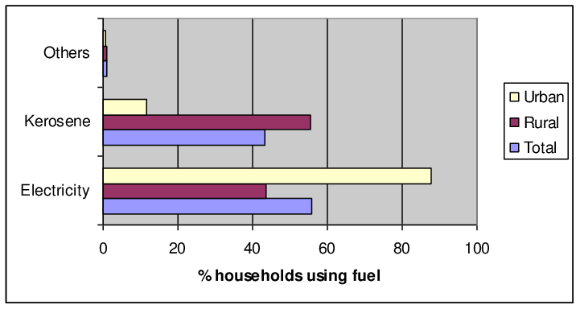
Selective Indicators…………..
Distribution of Households by Source of Lighting - 2011

Slide 14
Selective Indicators………….
Distribution of Households by Drinking Water Within Premises- 2011
Distribution of Households having Telephone - 2011

Slide 15
Rural Development Programmes..
The Government of India is involved in a large number of programmes in sectors/area such as education, health, labour, skill development etc. through both Centrally Sponsored Schemes (CSS) and provision of Central Sector Schemes.
Some of the important Flagship Programmes being run/ implemented by the Government of India in various States are;
Mahatma Gandhi National Rural Employment Guarantee Act (MGNREGA)
National Rural Drinking Water Programme (NRDWP)
Indira Awaas Yojana (IAY)
National Rural Health Mission (NRHM) renamed as National Health Mission.
Sansad Adarsh Gram Yojna
Pradhan Mantri Gram Sadak Yojna
Bharat Nirman Yojna

Slide 16
Bharat Nirman Yojna
Recognizing the role played by infrastructure in poverty removal, the Government of India launched a time-bound massive plan under Bharat Nirman in 2005 for implementation during the four-year period, 2005–09. The first half of the programme was in the Tenth Plan period and the second half coincides with the first two years of the Eleventh Plan period (2007–12).
The scheme has six components, they are;
Irrigation,
Drinking Water,
Electrification,
Roads,
Housing, and
Rural Telephone.

Slide 17
Targets under Bharat Nirman
The objective of the Bharat Nirman Programme is to impart a sense of urgency to create rural infrastructure by setting time-bound goals under various schemes which form a part of the Bharat Nirman Programme.
Component | Targets to be Achieved by Year 2009
Irrigation | To create 10 million ha of additional irrigation capacity.
Roads | To provide all-weather roads to every habitation over a 1000 population and above (500 in hilly and tribal areas); 66802 habitations to be covered.
Electricity | To provide electricity to remaining 125000 villages and to 23 million households.
Housing | To construct 60 lakh houses
Drinking water | To provide drinking water to 55067 uncovered habitations by 2009. All habitations with failed sources and water quality problems will be addressed.
Telephone connectivity | To connect remaining 66822 villages with telephone by 2007.

Slide 18
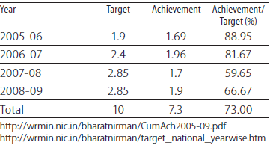
Irrigation
The ultimate irrigation potential for the country has been estimated as 139.88 million hectare (Mha). So far, the irrigation potential of 99.36 Mha has already been created.
Bharat Nirman ambitiously targeted the creation of an additional 10 million hectare irrigation potential by 2009- 10 through major, medium and minor irrigation projects complemented by ground water development.
Achievement and Target in irrigation Potential (Mill Hect)
By the end of March 2010, additional irrigation capacity of 7.3 million hectare were created, thereby leaving a gap of 2.7 million hectare irrigation potential. It was during the second phase (i.e. 2010-2011 and 2011-12), in which the creation of irrigation potential, suppressed the original target fixed for this component by 1.16 million hectares.

Slide 19
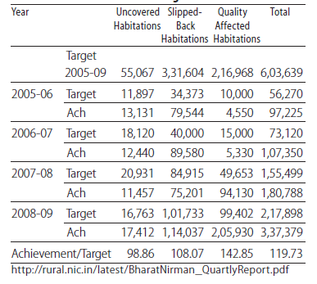
Drinking Water
Achievement and Target in Drinking Water (Accelerated Rural Water Supply Programme: ARWSP)
Water supply is a basic need of human being and critical for public health.
55,067 un-covered habitations had to covered during the Bharat Nirman period.
100% of the target achieved well before March 2012 in case of all categories.
Nearly 100% in case of coverage of uncovered habitations.
108% of the target has been attained in case of slipped back habitations
142% in case of quality-affected habitations

Slide 20
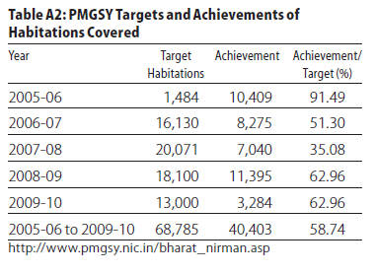
Road
Rural roads are the most essential infrastructure for socio-economic uplift of the rural community.
Bharat Nirman entailed providing connectivity to all habitation of 1000 and above (500 and above in the case of hilly states, tribal and desert areas by all weather road by 2011.
The programme envisaged to provide connectivity to 63,940 habitations
It was embedded in the PMGSY with a wider funding base and extended scope.
Achievement record for upgradation is fairly good at 93%. For new connectivity it is only 62%. For habitations to be covered the achievement rate is under 58.74%
Achievement and Target in Road (PMGSY)

Slide 21
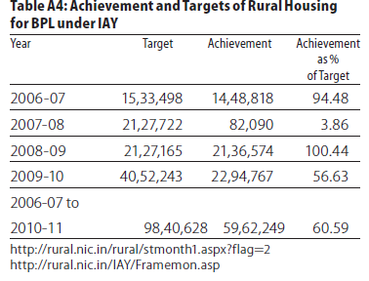
Rural Housing
The programme has set a target to construct 60 lakh houses from 2005 to 2009.
The housing component under the Programme was implemented in parallel with IAY scheme.
The cost of this project is shared between the centre and states on a 75:25 basis (90:10 for hilly areae)
The achievement of this programme has been somewhat erratic ranging from a low of 3.8% in 2007-08 to a high of 100.44% in 2008-09.
For the period between 2006-07 and 2010-11 the overall achievement has been 61%.
Achievement and Target of Rural Housing for BPL under IAY

Slide 22
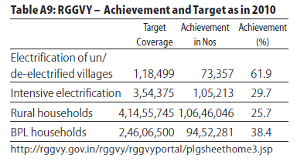
Electricity
Aims of this programme are (i) electrifying all villages and habitations as per the new definition, (ii) providing access to electricity for all rural households, and (iii) providing electricity connection to BPL families free of charge.
Target was to provide electricity to 1.25 lakh villages and 2.46 crore households living the below poverty line (BPL) during the four-year period.
The achievement is 62% for un/de-electrified villages; 30% for intensive electrification and as low as 25% for rural households and 38% for BPL households.
Achievement and Target of RGGVY

Slide 23
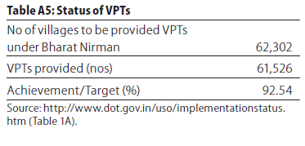
Village Public Telephone (VPT)
In this age of information era, the significance of enhancing rural connectivity can hardly be over emphasised.
Under the Bharat Nirman Programme, 66822 revenue villages not having telephone connectivity are to be provided with Village Public Telephone (VPT) facility.
Out of these, 14183 remotely located villages are to be provided VPTs through digital satellite phone terminals, while the remaining 52639 villages are to be provided any other technology.
By the end of 2007, telephone connectivity was provided to 61,526 villages (92.54%)
Achievement and Target of VPTs

Slide 24
Slide Title
India needed a big push in rural infrastructure
Since 2014, the emphasis was given on ease of living.
Safe drinking water, sanitation
Access to clean and affordable energy
Healthcare for all
Housing for all
Digital connectivity and financial inclusion,
Constructing roads and buiilding modern railway stations, airports, bus terminals and world-class educational institutes.

Slide 25
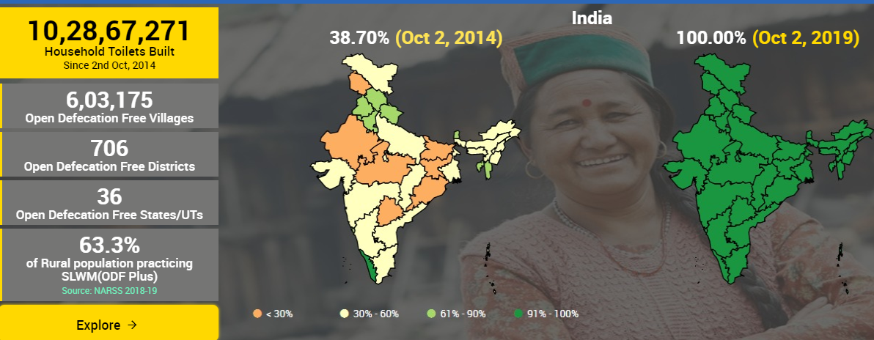
Slide Title
Swachh Bharat Mission ( Rural)
To achieve universal sanitation coverage and to put the focus on cleanliness, the Prime Minister of India had launched the Swachh Bharat Mission on 2nd October 2014.
38.70 per cent rural sanitation coverage in 2014 before the Swachh Bharat Mission (SBM)
Toilet coverage has increased dramatically at 100 %
10.28 crore toilets have been built since Oct, 2014

Slide 26
Slide Title
Village Electrification Programmes
Recently rural India observes a successful drive to provide electricity access to all villages and households through Deendayal Upadhyaya Gram Jyoti Yojana & Saubhagya Scheme
In 2014, Government identified 18,452 villages without electricity, and promised that every village would be electrified within 1,000 days.
The official dashboard of Saubhagya showed that government has electrified 99.99% Villages and Households .
Household Electricity Status - 2020

Slide 27
Slide Title
Rural Road Infrastructure (PMGSY)
Pradhan Mantri Gram Sadak Yojna started in the year 2000
Till 2003-4, only 8% of villages were connected with all-weather roads
As per PMGSY Report, 91% of the eligible and feasible habitations have already been connected by all-weather road till 2019.

Slide 28
Slide Title
India: Trend of Growth in Rural Road Length (Lakh kms)
1951 - 2017
The total length of rural roads in the country has increased significantly from 27.49 lakh kms in 2010-11 to 41.66 lakh kms in 2017

Slide 29
Slide Title
Village Electrification
Recently rural India observes a successful drive to provide electricity access to all villages and households through Saubhagya Scheme
In 2014, Government identified 18,452 villages without electricity, and promised that every village would be electrified within 1,000 days.
The official dashboard of Saubhagya showed that government has electrified 99.99% Villages and Households .
Household Electricity Status - 2020

Slide 30
Slide Title
Pradhan Mantri Jan Dhan Yojna (PMJDY)
In a diverse country like India, financial inclusion is a critical part of the development process.
PMJDY is a National Mission for Financial Inclusion, particularly to provide access to financial services such as savings and deposit accounts, remittance, credit, insurance, pension, etc. at affordable rates. The scheme was announced in 2014 by Prime Minister Narendra Modi.
Under the PMJDY scheme 21.58 crore accounts have been opened in the rural and semi-urban parts of the country.
Nearly 82% of adults now have bank accounts as compared to merely 35% in 2011.
Accident Insurance Cover of Rs.1 lakh (enhanced to Rs. 2 lakh to new PMJDY accounts opened after 28.8.2018) is available with RuPay card issued to the PMJDY account holders.
Life Insurance Cover of Rs. 30,000 to eligible PMJDY account holders who opened their account for the first time between 15.8.2014 to 31.1.2015 is available.
An overdraft facility up to Rs. 10,000 to eligible account holders is available.
PMJDY accounts are eligible for Direct Benefit Transfer (DBT),

Slide 31
Slide Title
Digital India - High-Speed Internet Networks to Rural Areas
Vision Areas of Digital India
Digital India was launched in July 1st, 2015
Aims to transform the country into a digitally empowered society and knowledge economy.
Have huge potential to provide new opportunities and challenges for Rural India (1 Trillion USD ecosystem by 2025)

Slide 32
Slide Title
Digital India – Achievements till 2019
Claims to connect 250,000 gram panchayats with a network of 3.40 lakh km of optical fibre,
Direct benefit transfers (DBT) of Rs 7.44 lakh crore using Jan Dhan, Aadhaar and Mobile to beneficiaries in 439 schemes
Has trained 2.21 crore beneficiaries under PMGDISHA digital literacy program
Around 3.76 lakh common service centres for govt schemes established offering digital services
Digital payment transactions at an all-time high. In March 2019 the total number of digital transactions was whopping 332.34 crore
Number of transactions via BHIM-UPI were at an all-time high 3 lakh Crore (March 2019 at 79.9 crore)
To provide IT jobs in semi-urban areas, the govt opened 202 BPO centres in 100 small & medim towns
India emerged as the second largest mobile phone manufacturer in the world with 268 mobile handset
Prior to 2014, only 5 dozen panchayats had the optical fiber network now it is 1.5 lakh panchayats

Slide 33
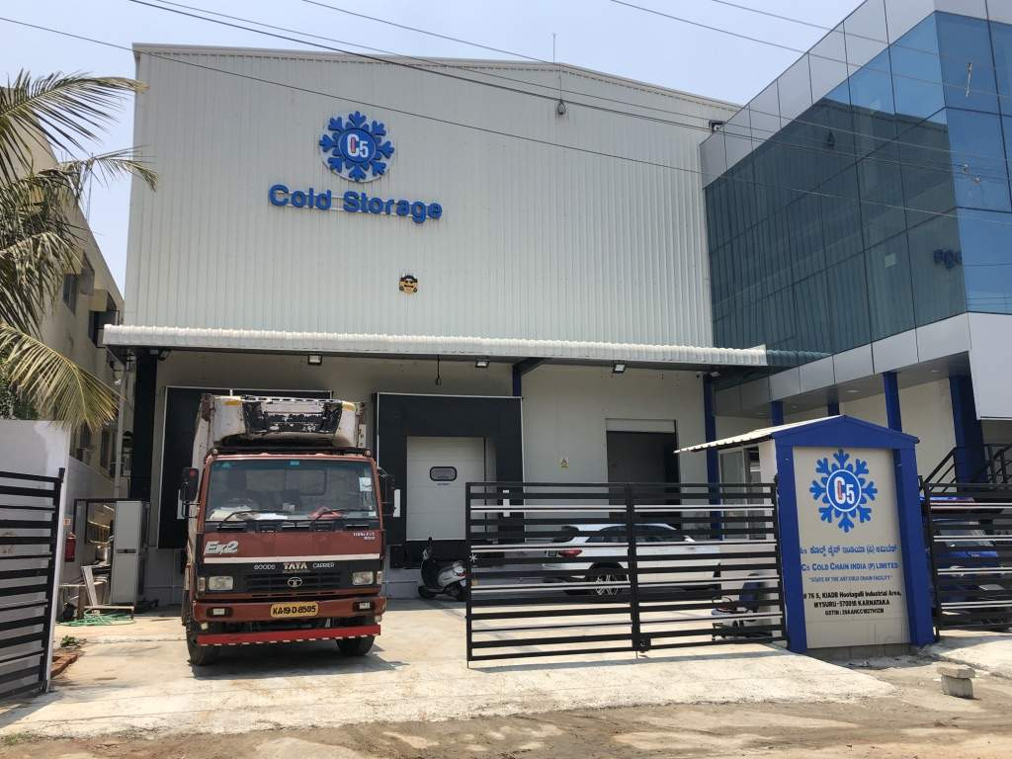
Slide Title
Storage & Warehousing for Agriculture Sector
Agricultural produce being perishable in nature the farmers are compelled for distress sale soon after production
Discourage distress sale by farmers and to encourage them to store their produce in warehousing. India is facing acute shortage of organized and good quality warehousing and storage infrastructure for agricultural commodities.
Around 20 to 40% of total produce is lost post-harvest due to lack of cold storage spaces.
Current cold storage capacity is estimated to be about 25 mill.MT against the total demand of approximately 60 mill. MT, leading to a shortfall of about 30 million to 35 mill. MT. (ASSOCHAM, 2020)

Slide 34
Slide Title
Pradhan Mantri Kisan Sampada Yojana (PMKSY)
Union finance minister in her 2020 budget has announced the setting up of storage facilities at villages as part of the Creation of Backward and Forward Linkages (CBFL) under the Pradhan Mantri Kisan Sampada Yojana (PMKSY).
The proposed facilities will be run by women self-help groups (SHG) and are expected to reduce logistics cost of farmers. State governments will provide the land for the facilities, they will be constructed on a public-private partnership (PPP) model.
NABARD will create warehouse facilities for food crops at block / taluka levels.
NABARD has been tasked with geo-tagging the 162 million metric tonnes (mmt) of warehousing, cold storage, etc, capacity which will help farmers with better market intelligence.

Slide 35
Slide Title
e -National Agriculture Market (NAM)
National Agriculture Market (NAM) is a pan-India electronic trading portal which networks the existing APMC mandis to create a unified national market for agricultural commodities.
Single National Agriculture Market (NAM) in the country, with a view to enable farmers to get a better price and for consumers to pay a lower price for agri-produce, a win-win situation at both ends of agri-value chains.
NAM addresses the price fluctuation by creating a unified market through online trading platform, both, at State and National level.
The Dalwai Committee on Doubling Farmers’ Income has pointed out that the share of farmers in consumer’s price is very low; it generally varies from 15 to 40 per cent.

Slide 36
Slide Title
Cont….
Middlemen are primarily responsible for farmers not realising a reasonable price for their produce, lowering farm income and profitability.
One Nation One Market -Farmers can sell the produce across the Nation to get better Price and at the same time can save himself from hassle of mandi.
Farmers will be able to place their produce in WDRA accredited warehouses avail the benefit of pledge loan if required.
Create jobs and promote efficient agri-value chains.
Real time price discovery for better & stable price realization for producers
Reduced transaction cost for buyers

Slide 37
Slide Title
Conclusion
Providing adequate infrastructure is an important step in the process of rural development
Road, links small and marginal farmers to the markets and reduces the market risk and high transaction costs they face.
States with better infrastructure facilities are more attractive for domestic and foreign private investment, and perform better in terms of economic growth.
Punjab and Haryana were pioneered in the green revolution had a running competition in claiming to be first in achieving some landmarks relating to the building of rural infrastructure. While Haryana claimed to be the first to have provided electricity to each village, Punjab claimed to be the first to have connected each village with a metalled road.

Slide 38
Slide Title
Effect of Infrastructure on Rural Development
Indonesia, Malaysia and Thailand have been highly successful in integrating agriculture with the rest of the economy.
China also integrated its agricultural sector with industrial sector.
As per NCAER study, the development of rural infrastructure could promote economic growth and improve the standard of living of the rural population and reduces the incidence of poverty by generating both farm and non-farm employment and earning opportunities.
Basically, providing infrastructure services to meet the demands of agriculture, rural businesses, households, and other users is one of the major challenges of rural governance.

Slide 39
Cont……
A number of micro level studies have investigated how a greater investment in infrastructure raises agricultural productivity.
Binswanger et al. (1993), in a study of 13 states in India, found that investments in rural infrastructure lowered transportation costs, increased farmers’ access to markets, and led to substantial agricultural expansion. Better roads also lowered the transaction costs of credit services, resulting in increased lending to farmers, higher demands for agricultural inputs, and higher crop yields.

Slide 40
Slide Title
Conclusion: Infrastructure Development a continuous process
“The link between infrastructure and economic development is not a once and for all affair. It is a continuous process; and progress in development has to be preceded, accompanied, and followed by progress in infrastructure, if we are to fulfill our declared objectives of generating a self-accelerating process of economic development.”
Dr. V. K. R. V. Rao

Slide 41
Slide Title
Thank You

